Slide 1
Adding a pipeline stage in Salesforce
Example content only. Created by Runthru Software.

Slide 2
Navigate to Setup > Object Manager > Fields and Relationships > Stage

Slide 3
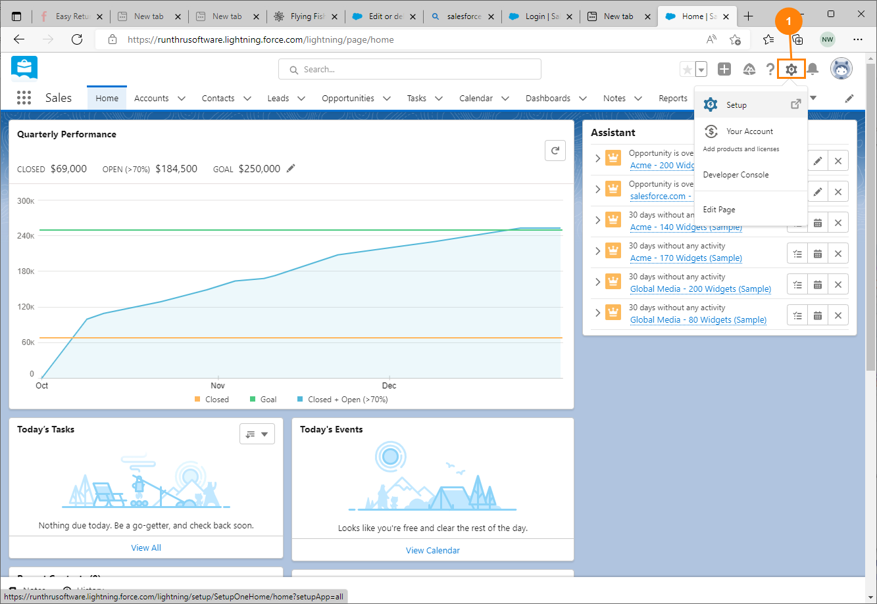
Main Window
1. Select the Setup Icon

Slide 4
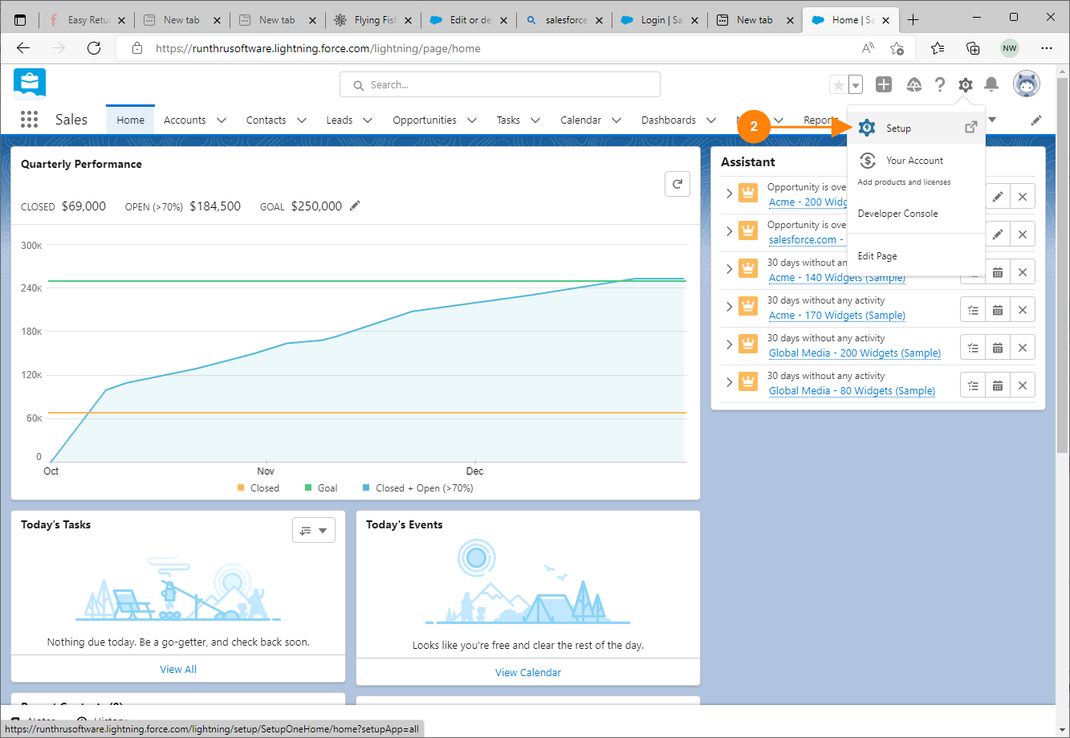
Main Window
2. Choose Setup from the menu

Slide 5
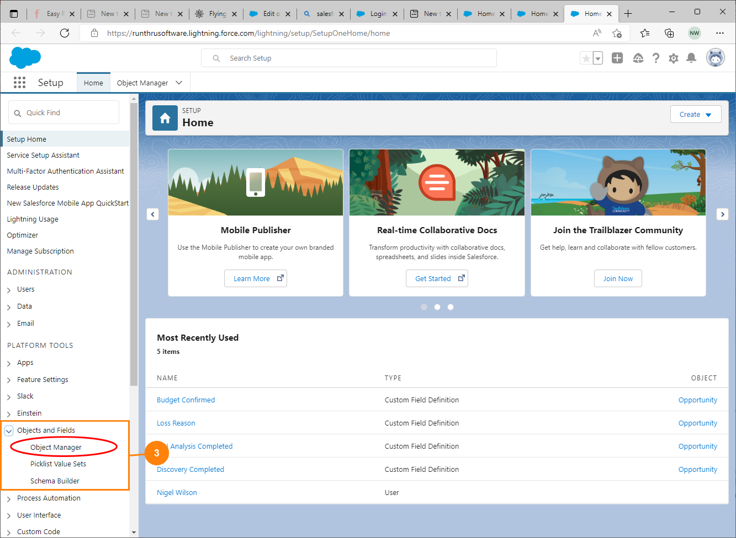
Navigate to Object Manager
3. Select Objects and Fields then Object Manager

Slide 6
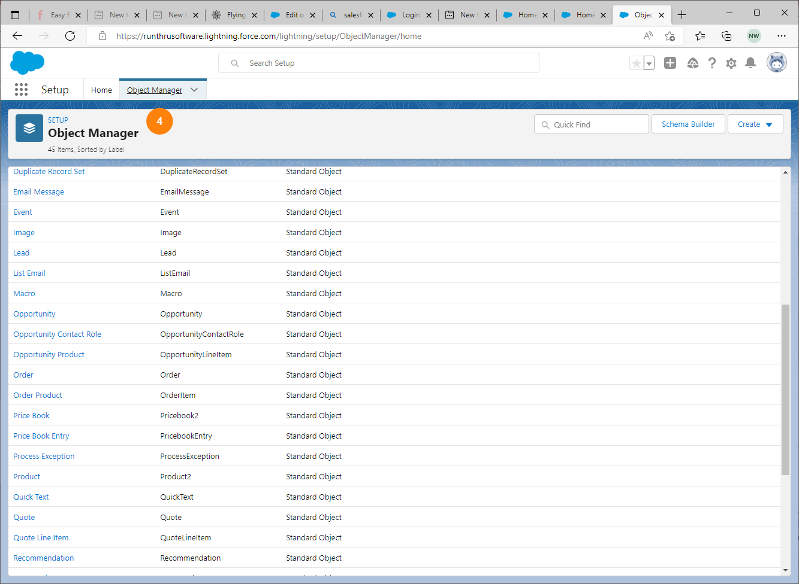
Navigate to Opportunity
4. The Object Manager list is shown.

Slide 7
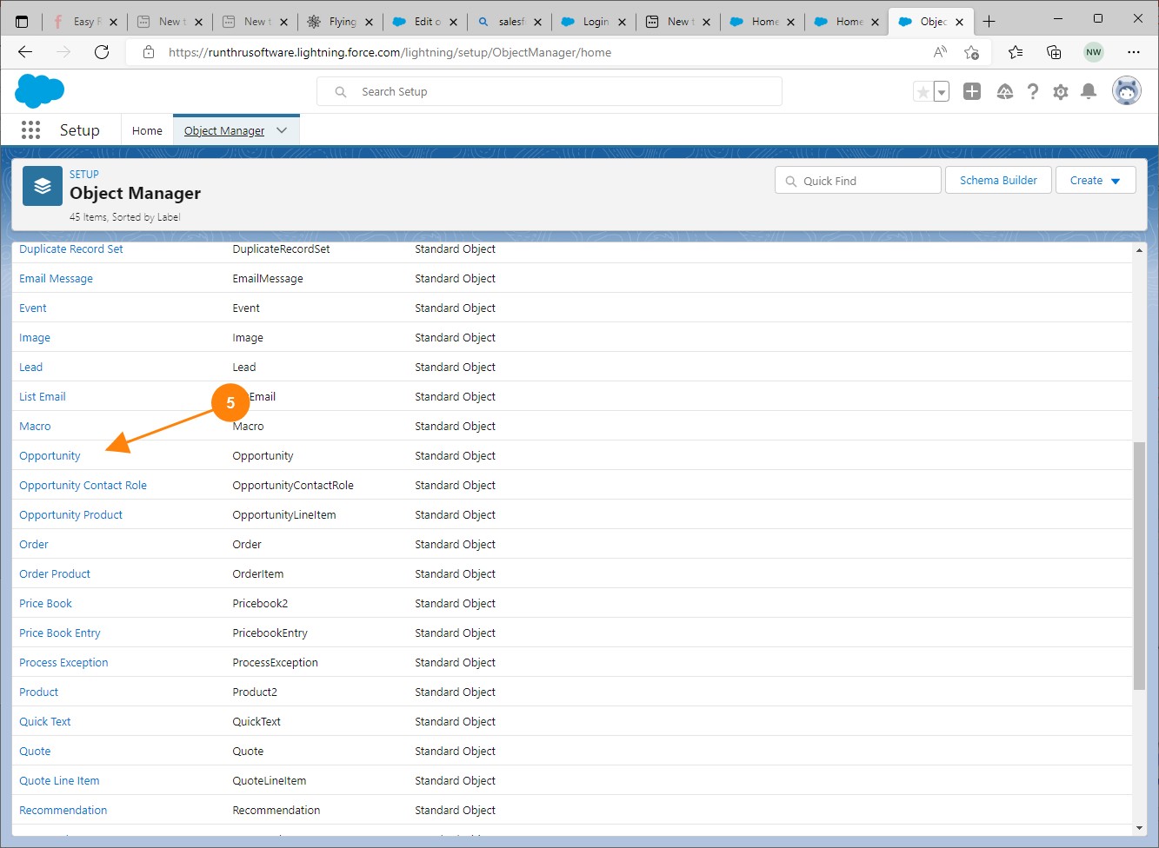
Navigate to Opportunity
5. Find and select Opportunity from the list.

Slide 8
Navigate to Fields and Relationships > Stage

Slide 9
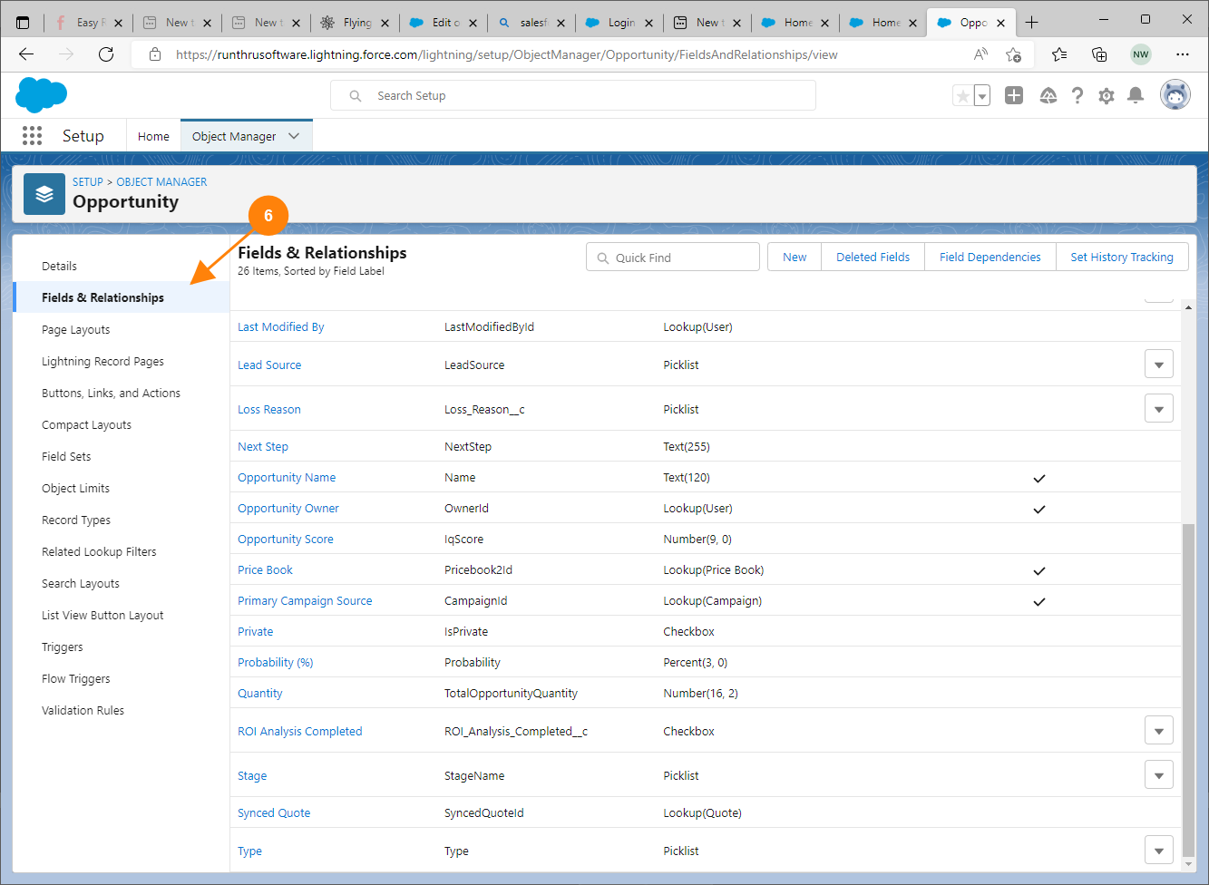
Navigate to Stage
6. Select Fields & Relationships

Slide 10
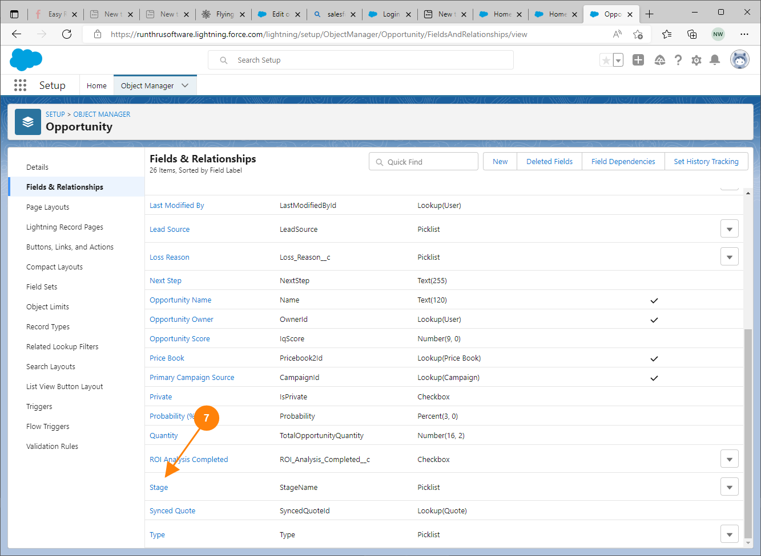
Navigate to Stage
7. Locate and select Stage

Slide 11
Create a New Stage in the Opportunity Stages Picklist Values section

Slide 12
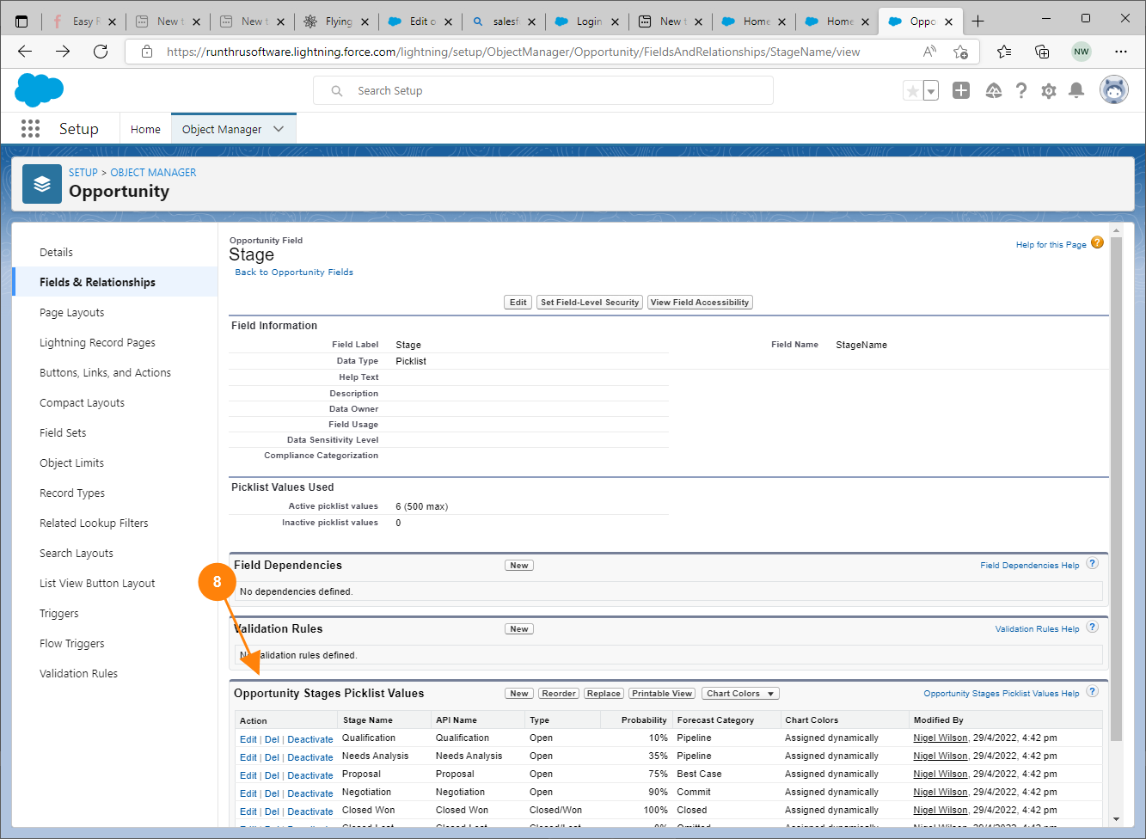
Create New Stage
8. Navigate to the Opportunity Stages Picklist Values

Slide 13
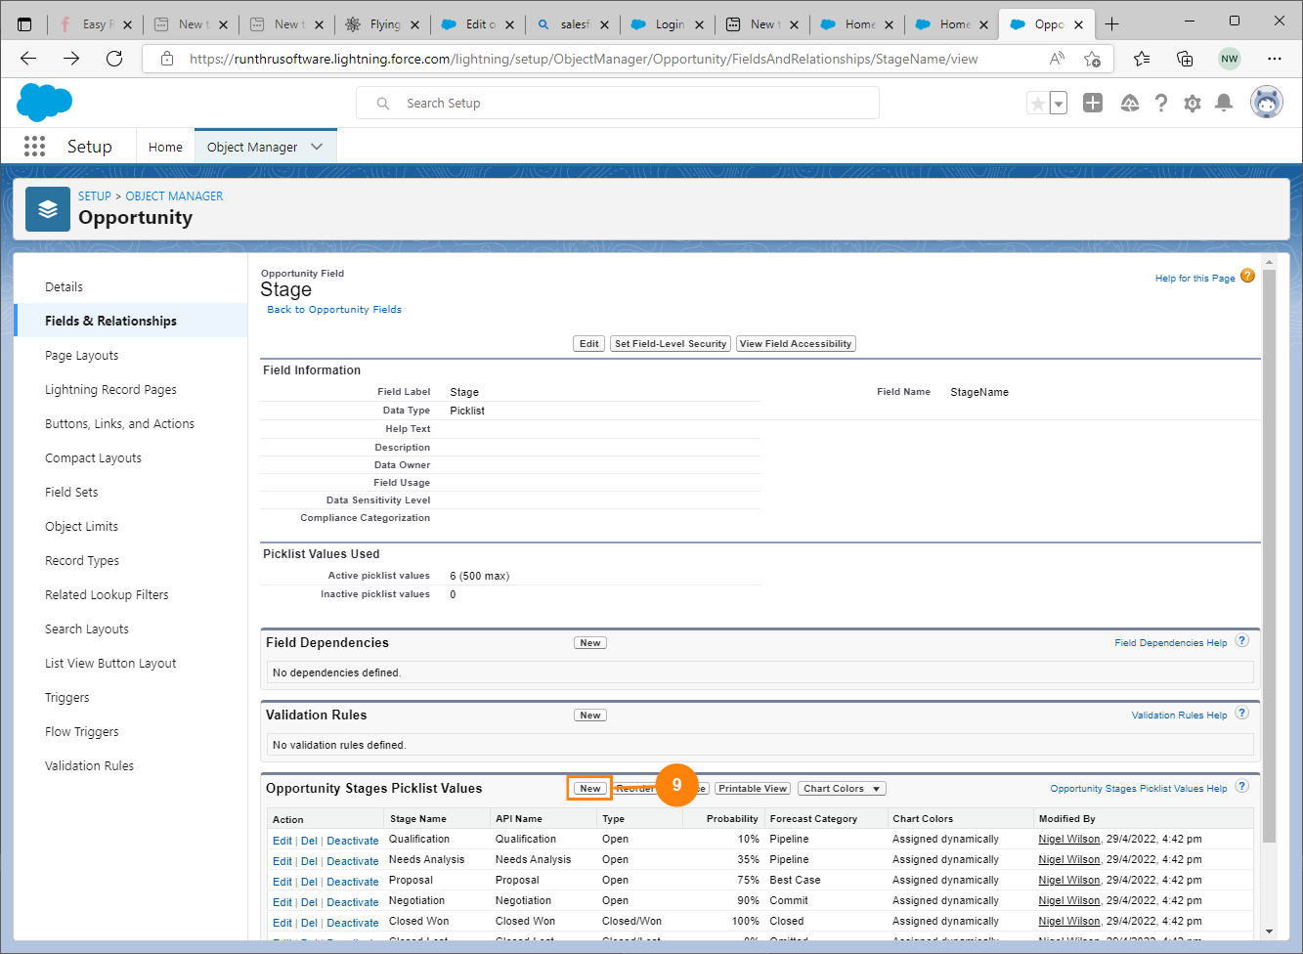
Create New Stage
9. Press New

Slide 14
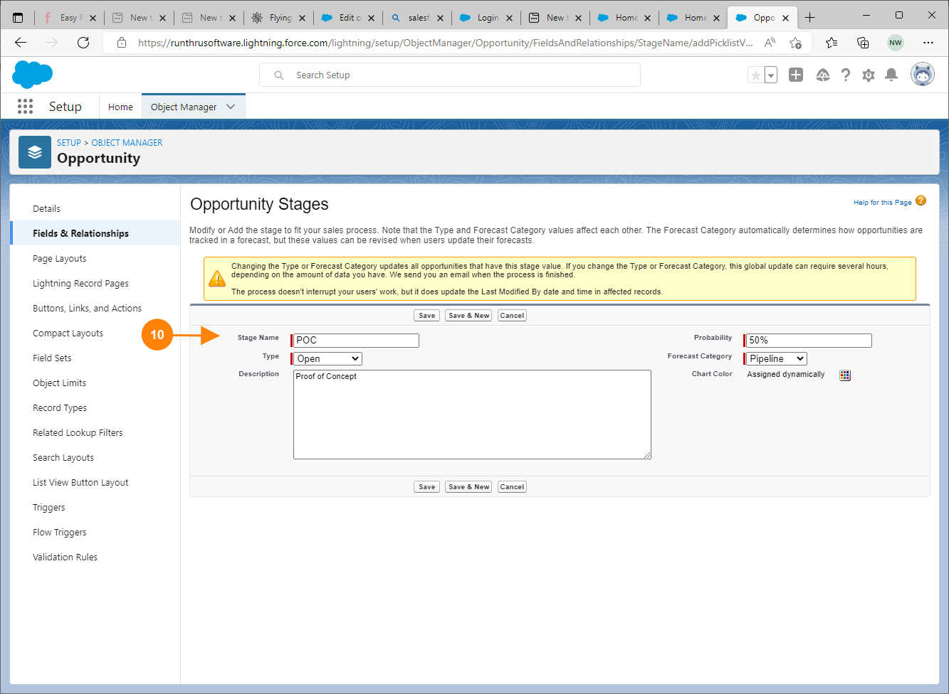
Create New Stage
10. Add a Stage Name

Slide 15
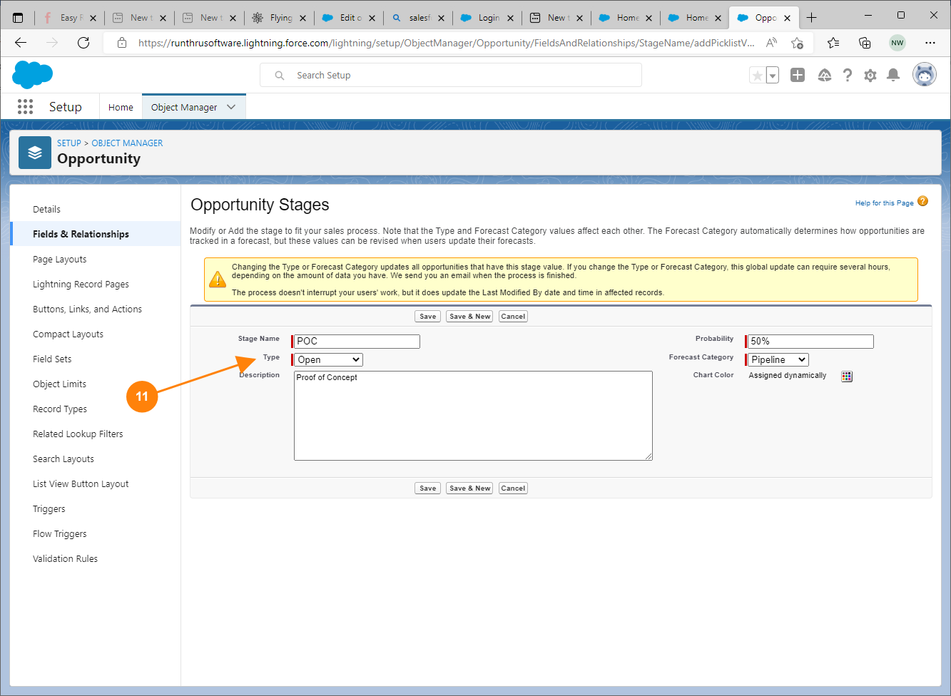
Create New Stage
11. Choose a Type from the list. Typically this will be Open

Slide 16
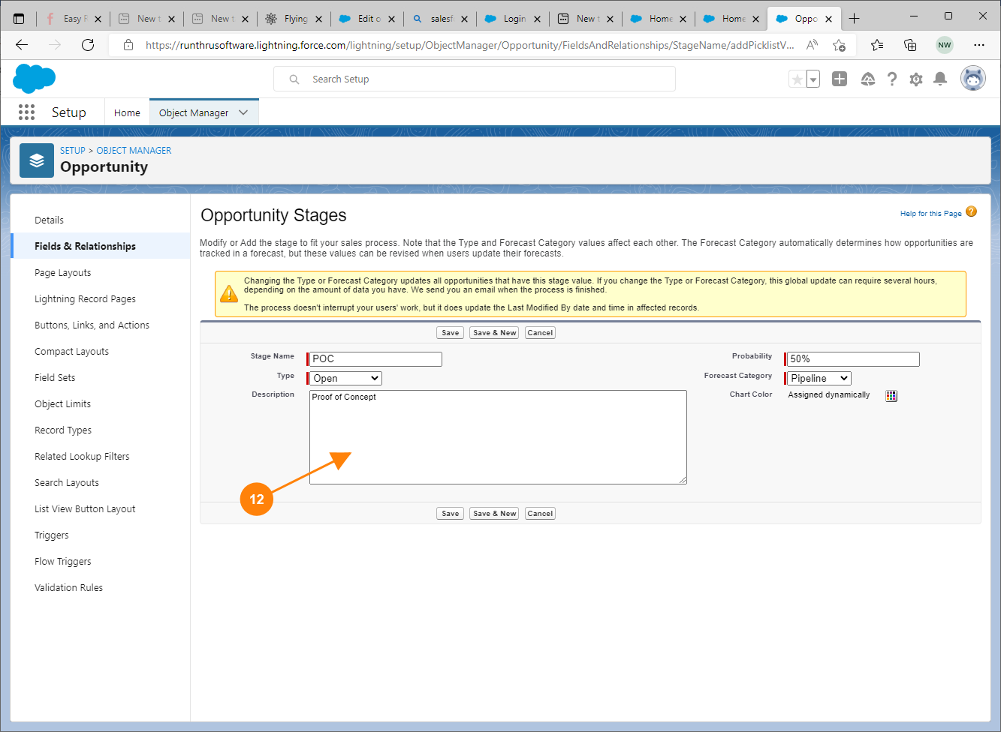
Create New Stage
12. Add a Description if necessary

Slide 17
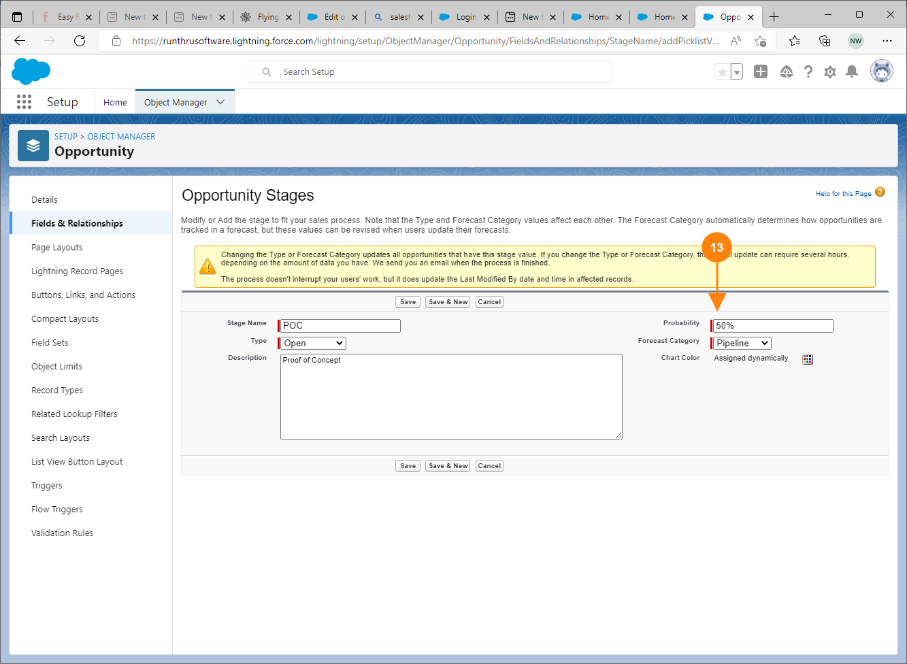
Create New Stage
13. Add a Probability of closing this opportunity in this new stage.

Slide 18
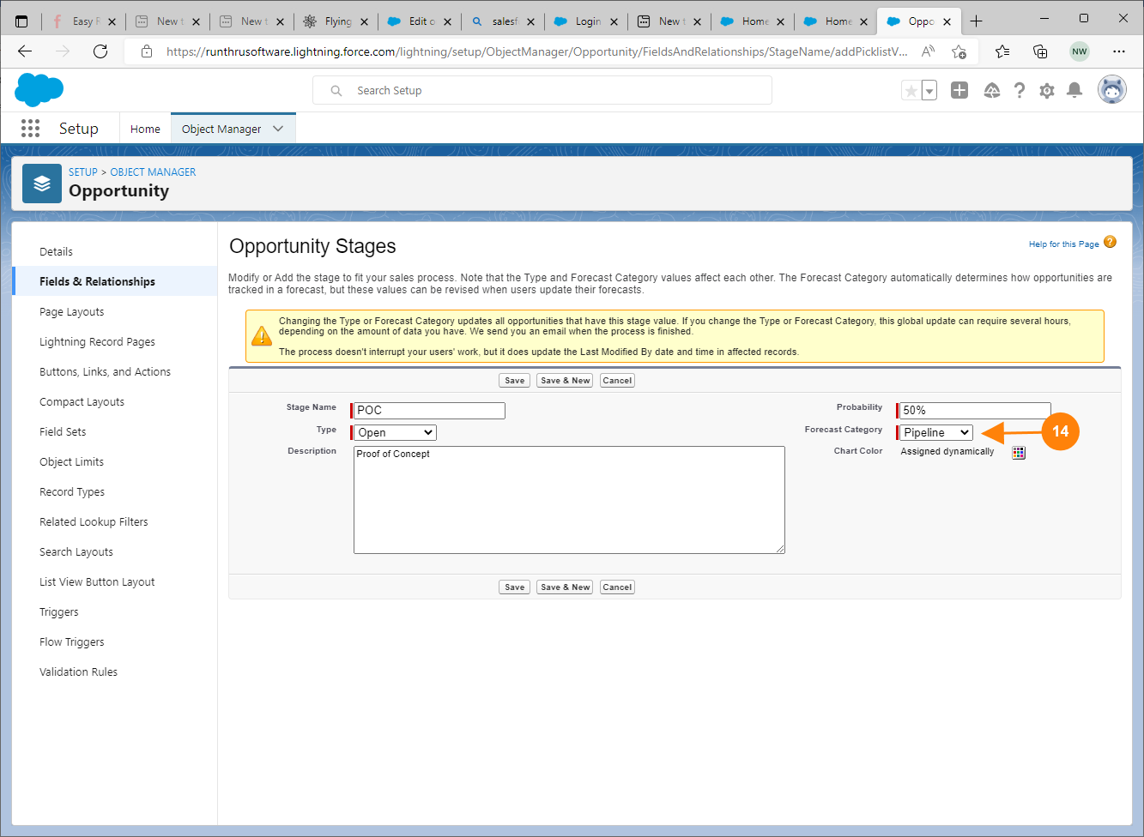
Create New Stage
14. Choose a Forecast Category. This will typically be Pipeline.
Other Options:
  Omitted - not a step at all
  Best Cast - maybe
  Commit - likely
  Closed - really likely

Slide 19
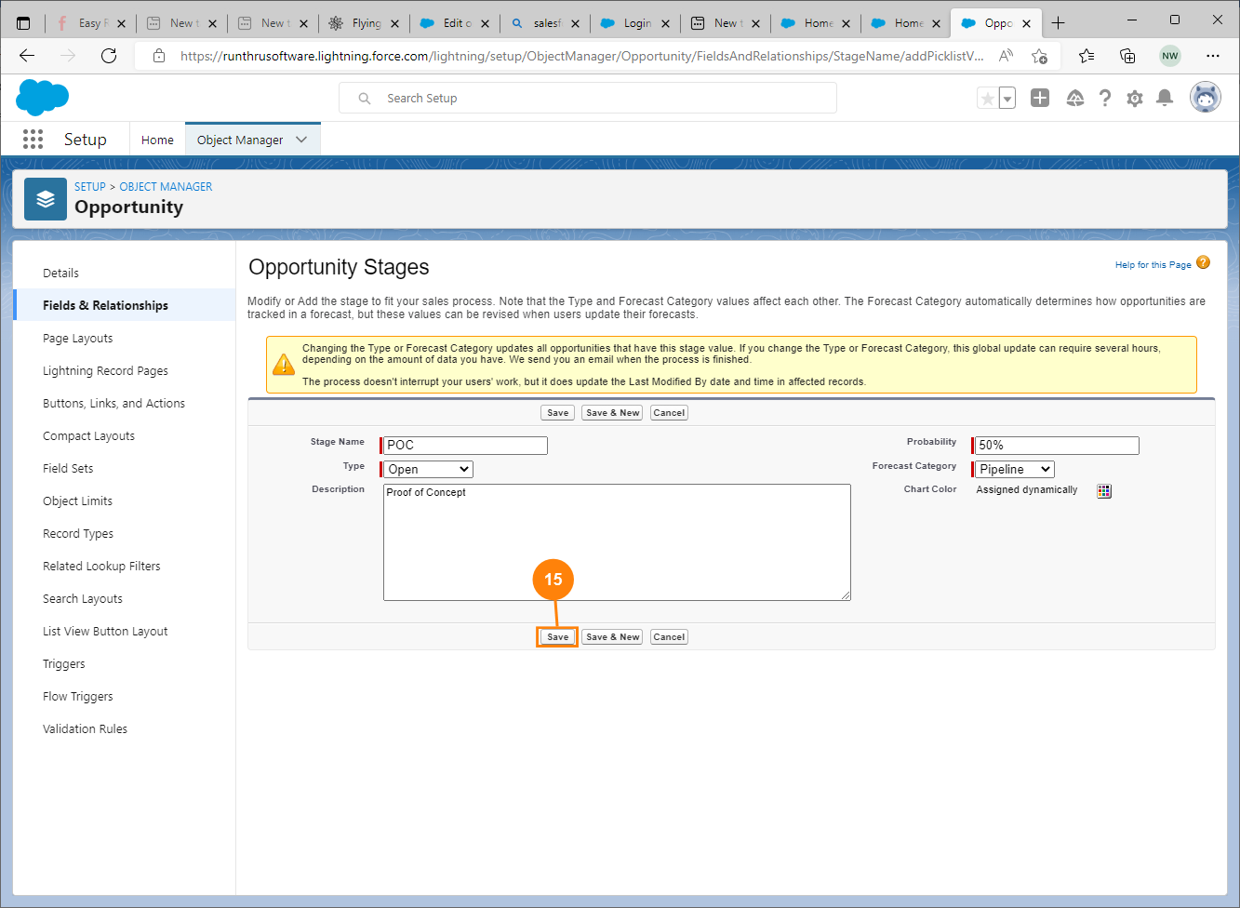
Create New Stage
15. Press Save

Slide 20
Reorder the new Opportunity Stage

Slide 21
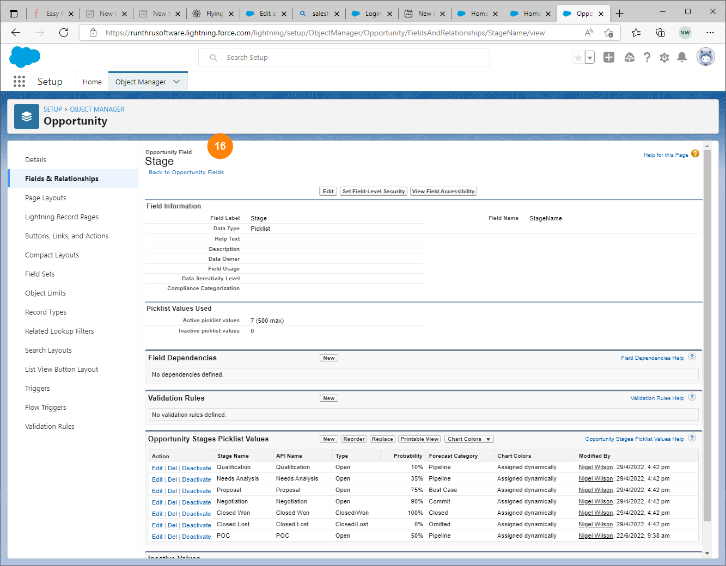
Navigate to Reorder
16. The Stage window is shown.

Slide 22
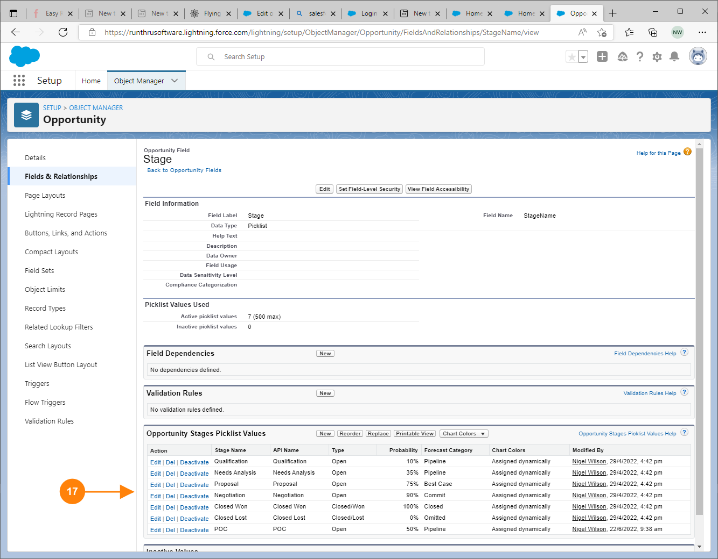
Navigate to Reorder
17. Your new stage is shown in the Opportunity Stages Picklist Values

Slide 23
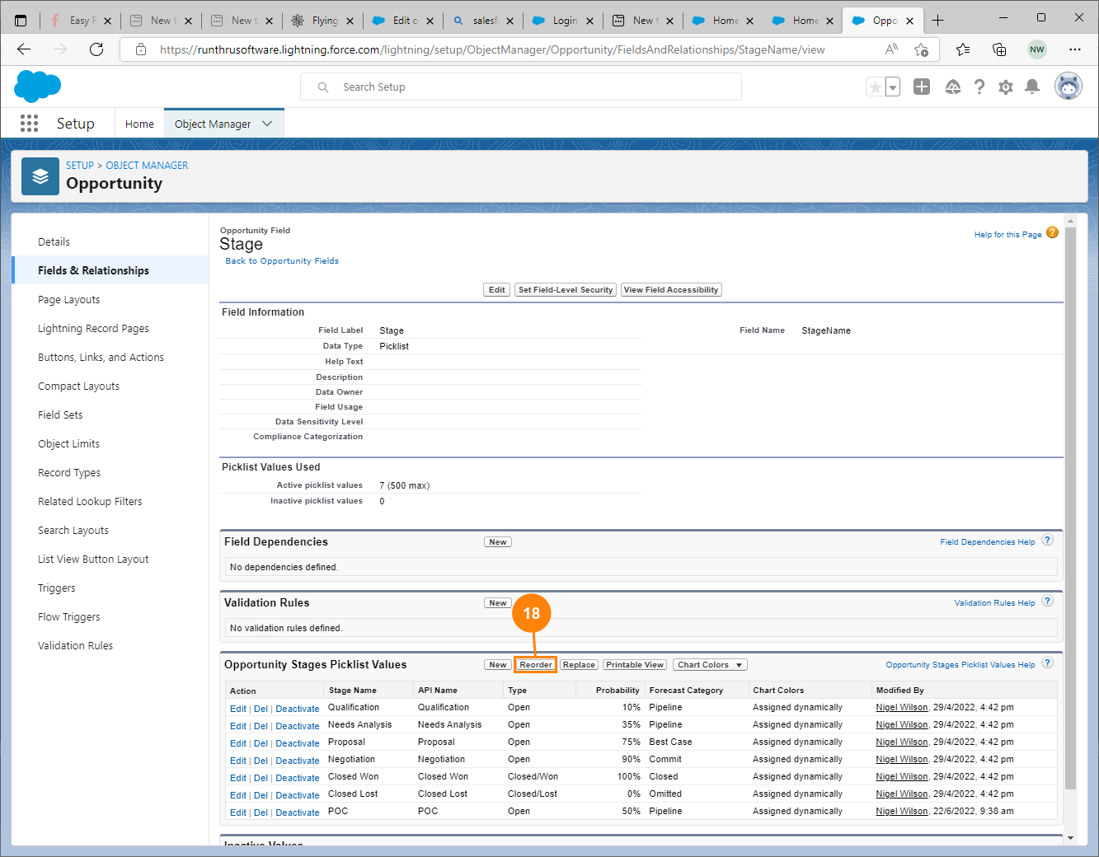
Navigate to Reorder
18. Press Reorder in this section

Slide 24
Complete the required field and Save

Slide 25
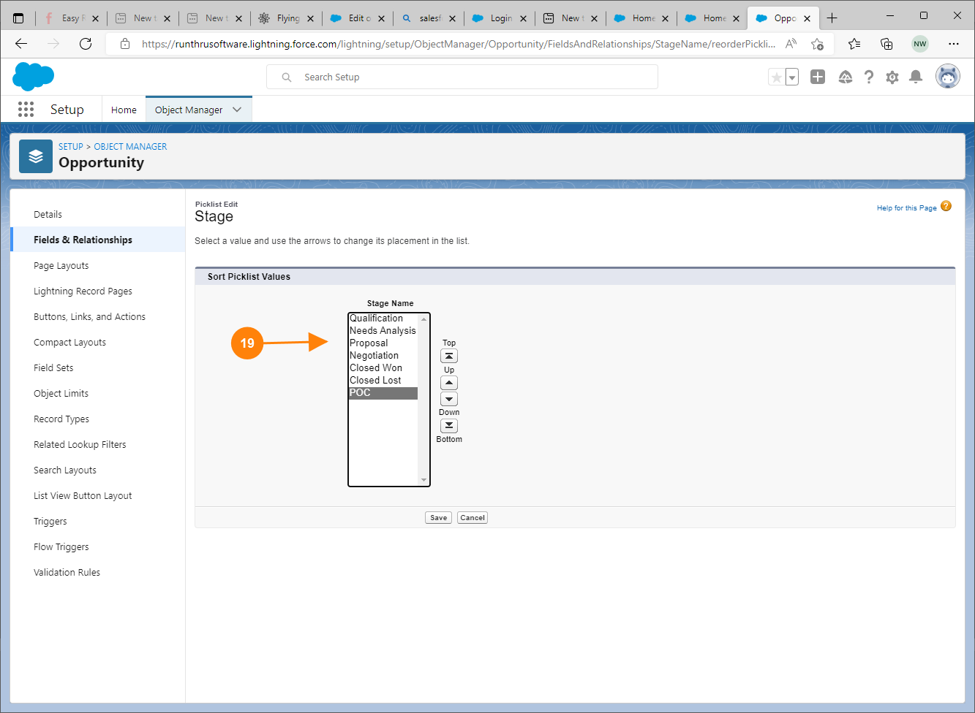
Reorder Stages
19. Select the new Pipeline stage in the list

Slide 26
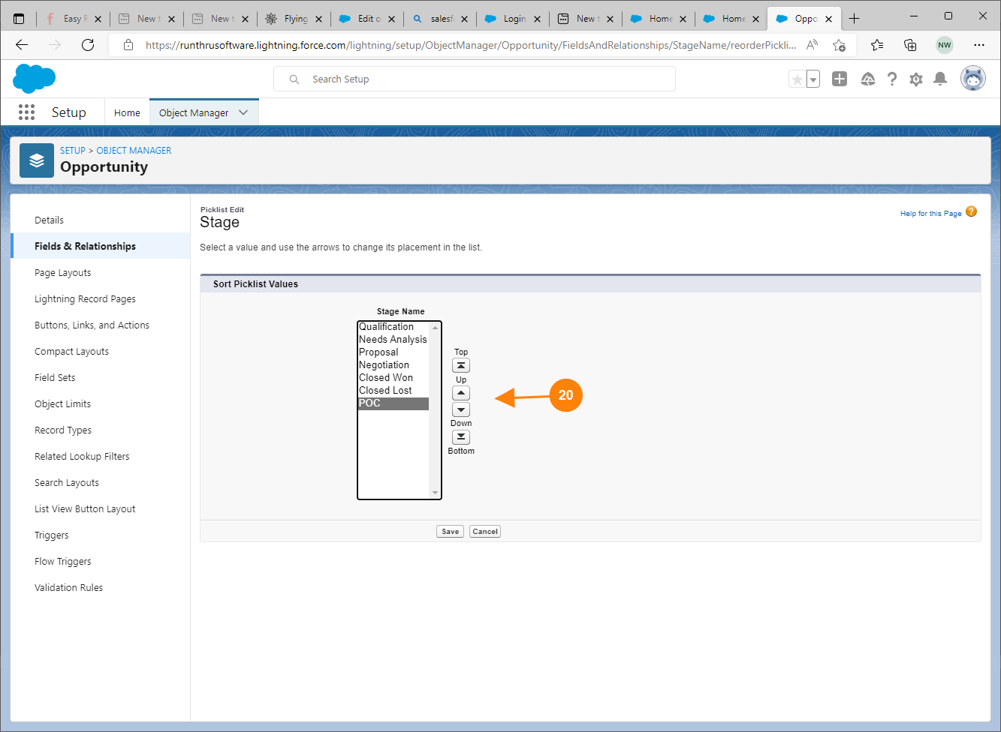
Reorder Stages
20. Use the buttons to reposition the new stage.

Slide 27
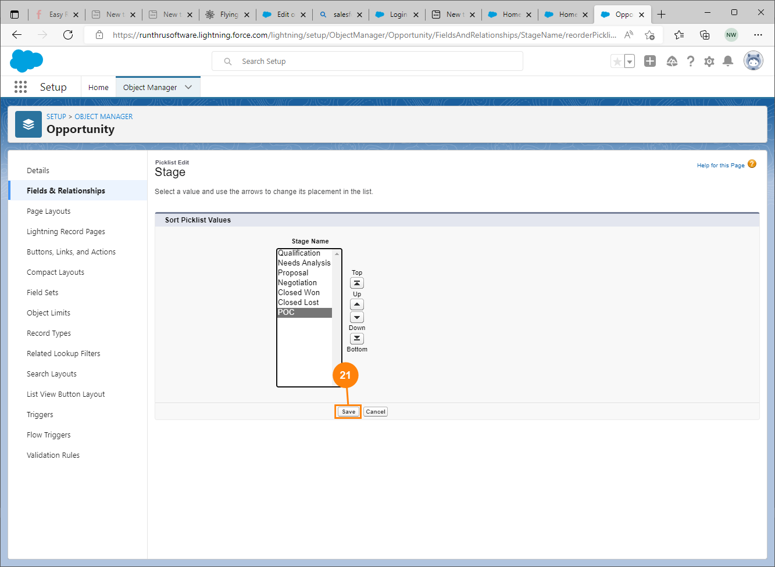
Reorder Stages
21. Press Save

Slide 28
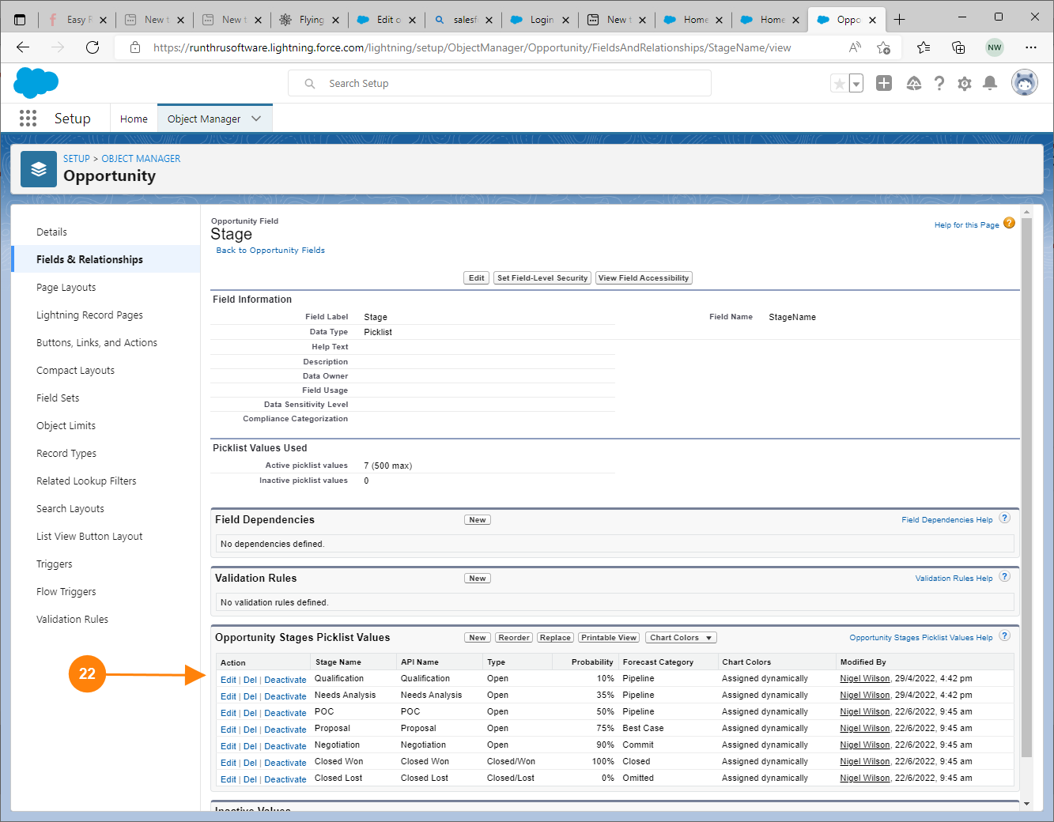
Final Screen
22. The stages should now be shown in the correct order.
End of procedure.

